Slide 1
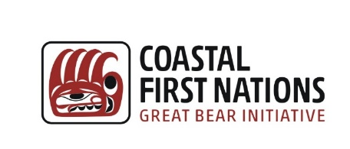
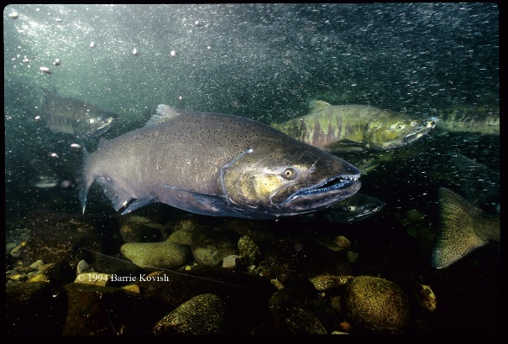
The Many Constructions of Salmon: How About Another One – Mine?
Paul Kariya, Coastal First Nation
American Fisheries Society, Kelowna
March 20, 2018

Slide 2

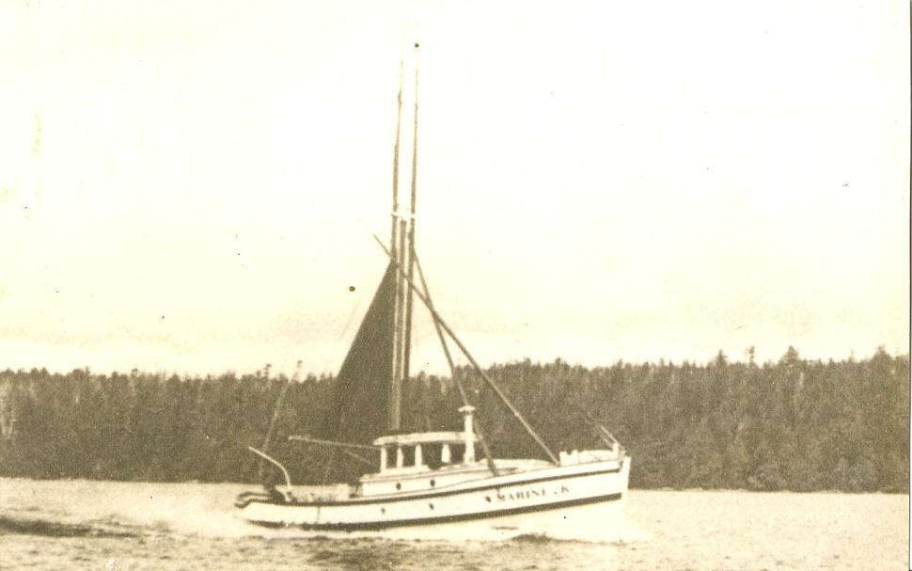
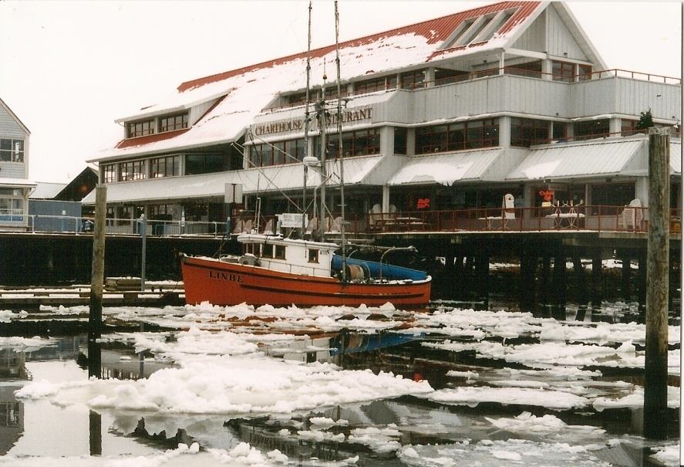
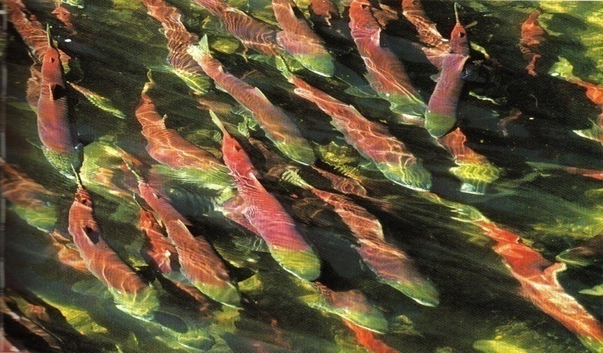
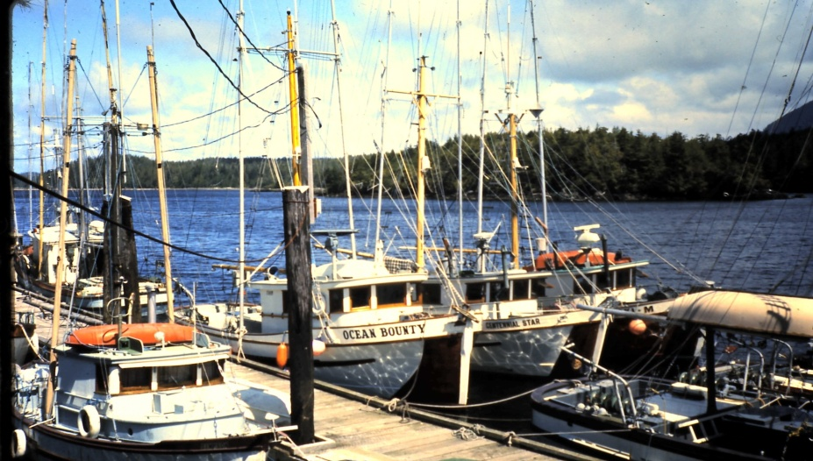
Son of a Fisherman

Slide 3

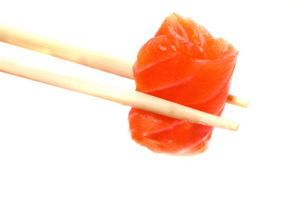
West Coast
Lifestyle

Slide 4
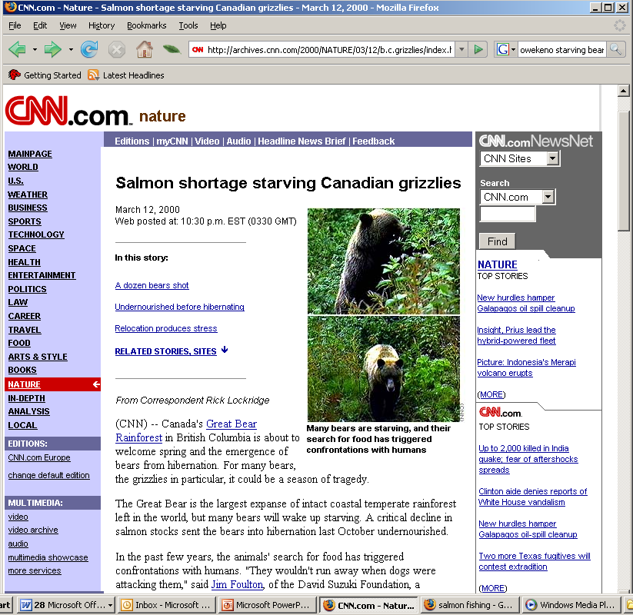
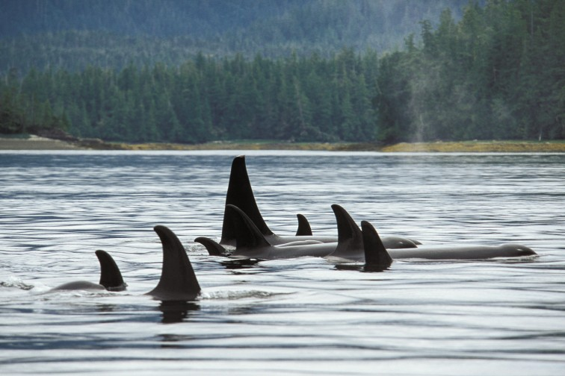
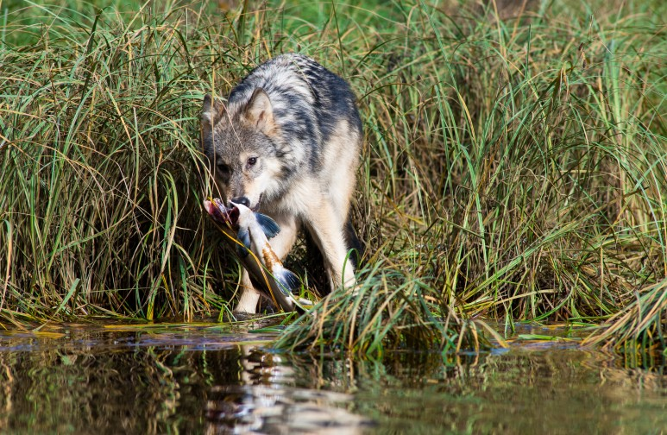
Ecosystems

Slide 5
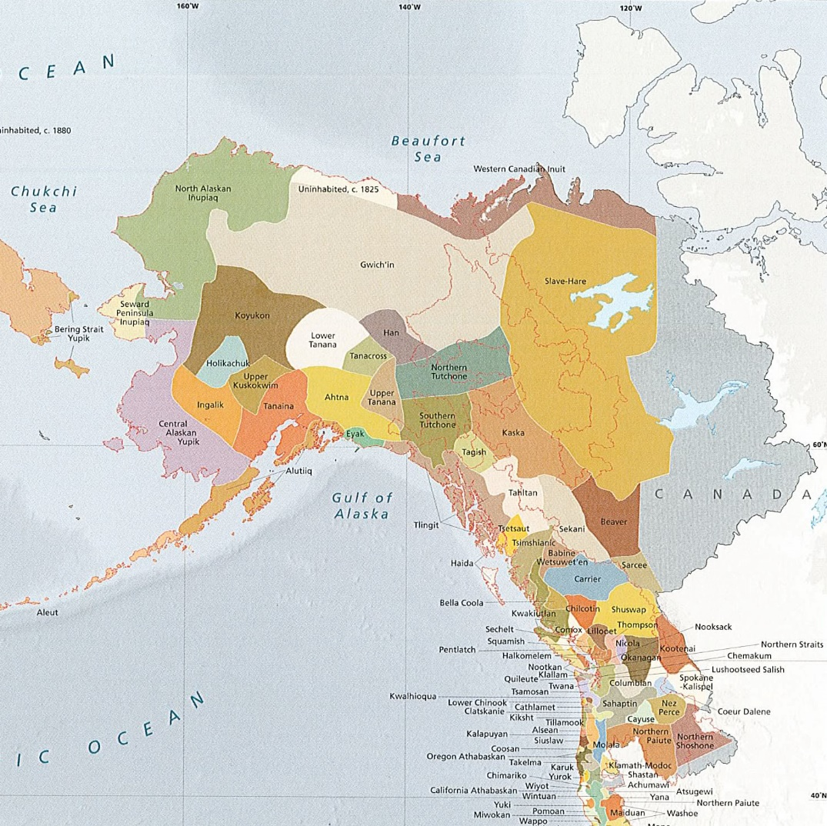
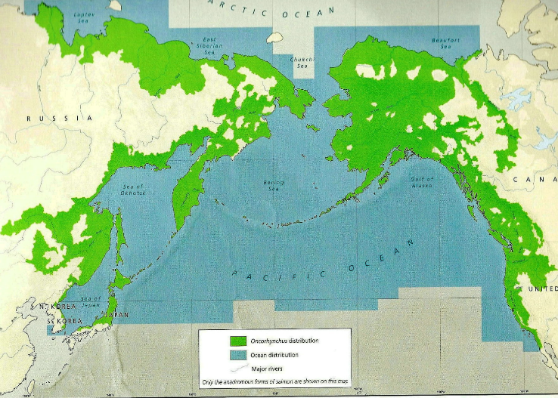

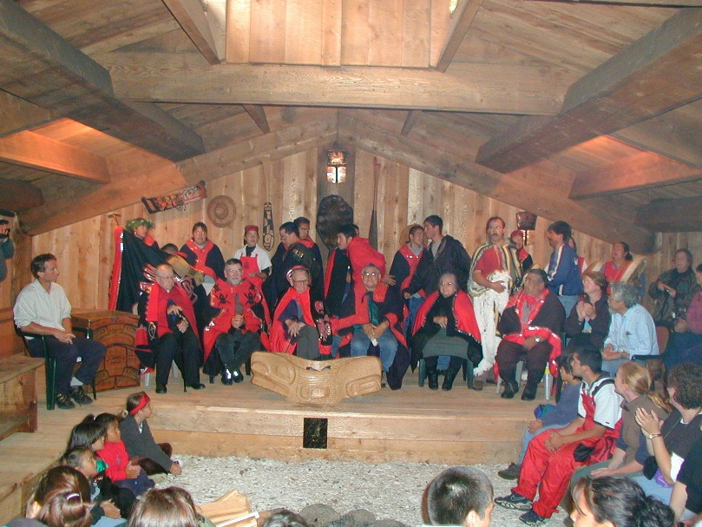
Pacific Salmon and First Nations

Slide 6
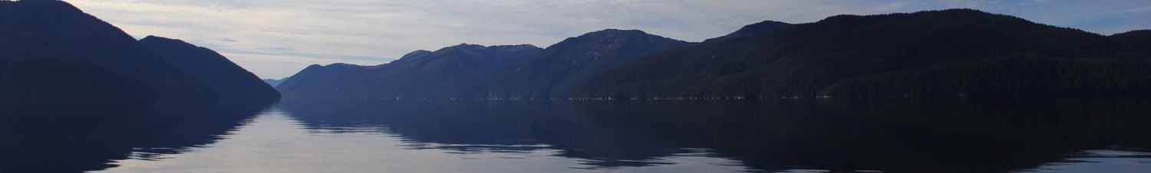
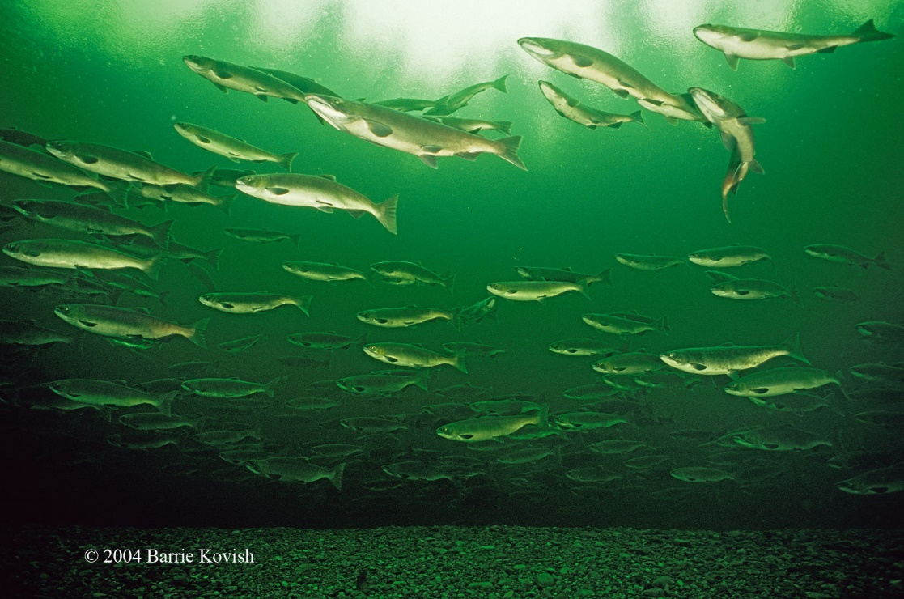
Economic Reconciliation - Policy Issues
Cultural and social survival
High unemployment and poverty
Current fisheries model is breaking down
Marginal recognition of FN Rights and Title
Economic leakage from the region
Coastal economies need investment + stewardship
Increasing foreign ownership
Reconciling joint management of fisheries
High risk of Litigation (Title and fish rights)

Slide 7
Fisheries Reconciliation between the First Nations of the North Pacific and CANADA
Vision – Coastal First Nations
Successful community based wild fisheries access and aquaculture development model
Sustainable growth of marine economy/jobs for region
FN’s achieve Canadian avg. employment levels
Acquisition of 20% of wild fishery
Joint-management of Oceans and Fisheries
Healthy, self-determined First Nations
New agreements and strong relationship with Canada
Reduced conflict and litigation – peace on the water

Slide 8
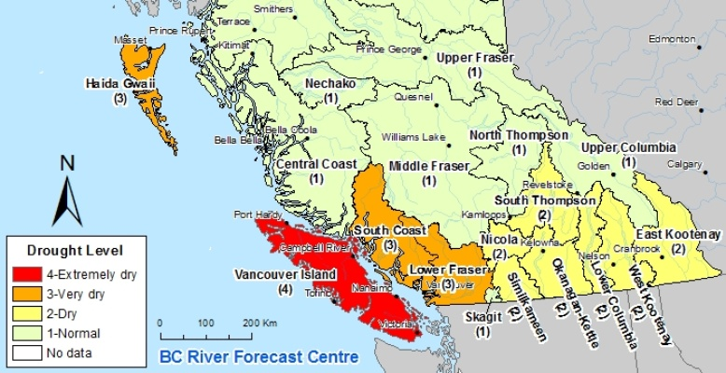
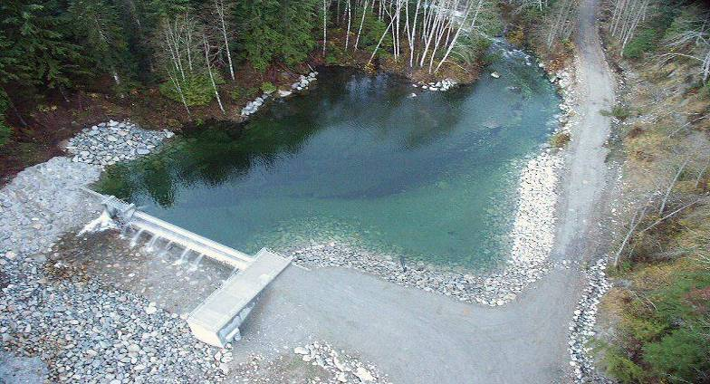
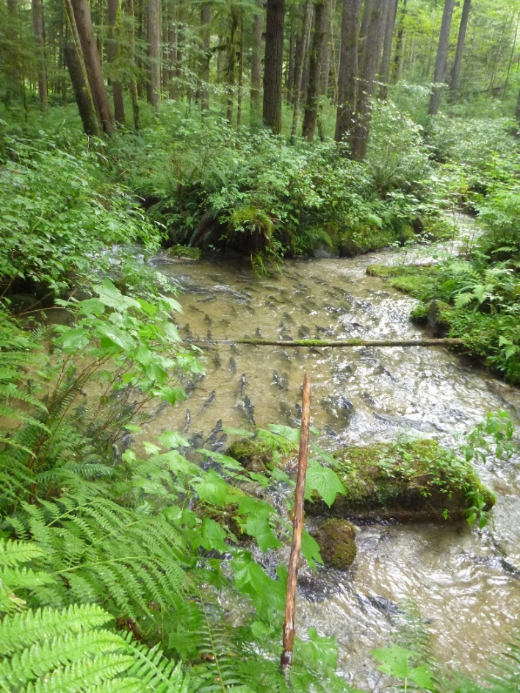
Drought and Possible Role for Renewable Energy

Slide 9
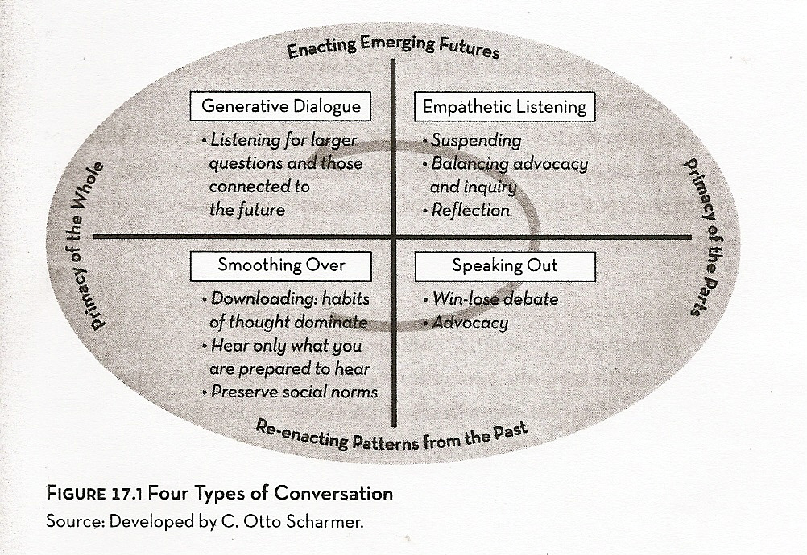
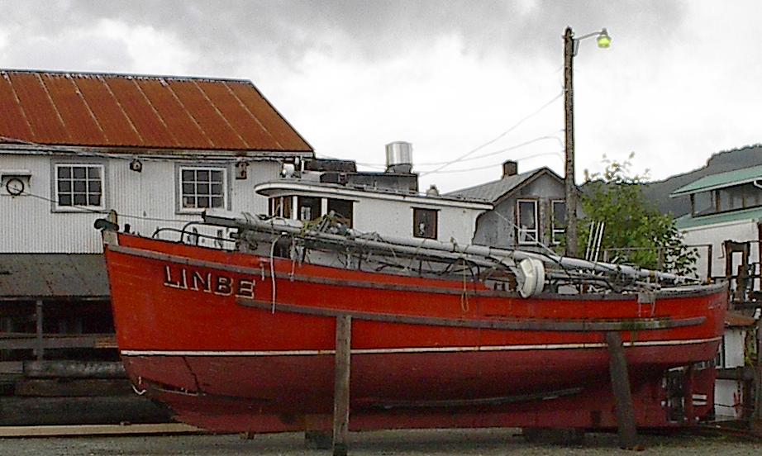
Future Constructions of Salmon – Shared Values to Action

