Slide 1
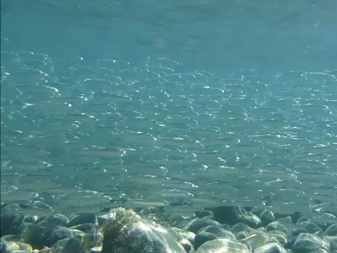


Predator-prey interactions between bull trout and juvenile sockeye salmon in Chilko Lake, BC
Nathan B. Furey
Notes:
5:27 – 6:09
69-27 = 42

Slide 2












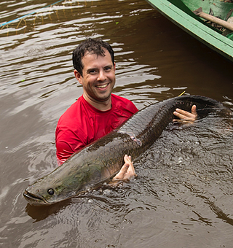


Steve
Christine
Erin Rechisky
David Welch
Adam
Steve
Kristi Miller
Jonathon
Armstrong
Eduardo Martins
Dave Beauchamp
Scott Hinch

Slide 3











Slide 4
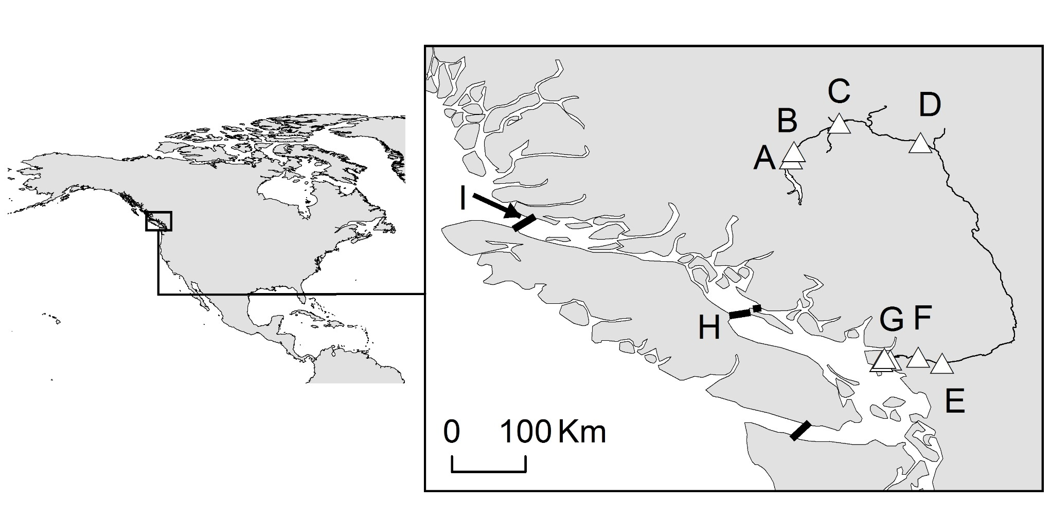
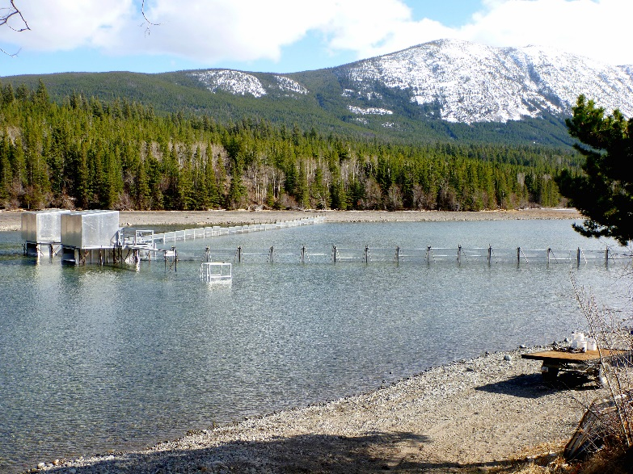
Chilko Lake and sockeye salmon smolts

Slide 5
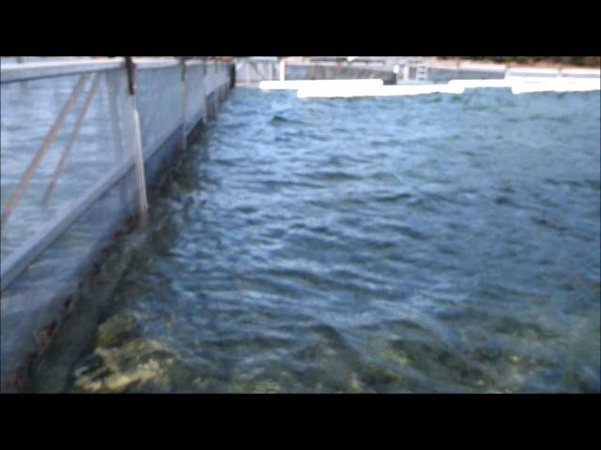

Slide 6
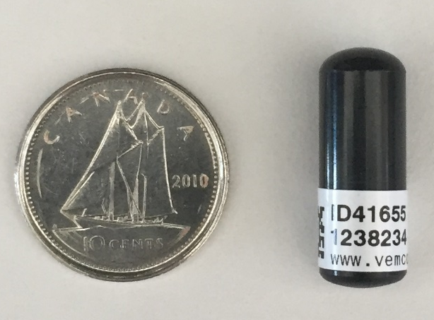
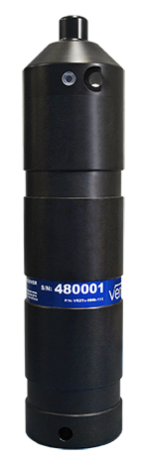
Acoustic telemetry

Slide 7
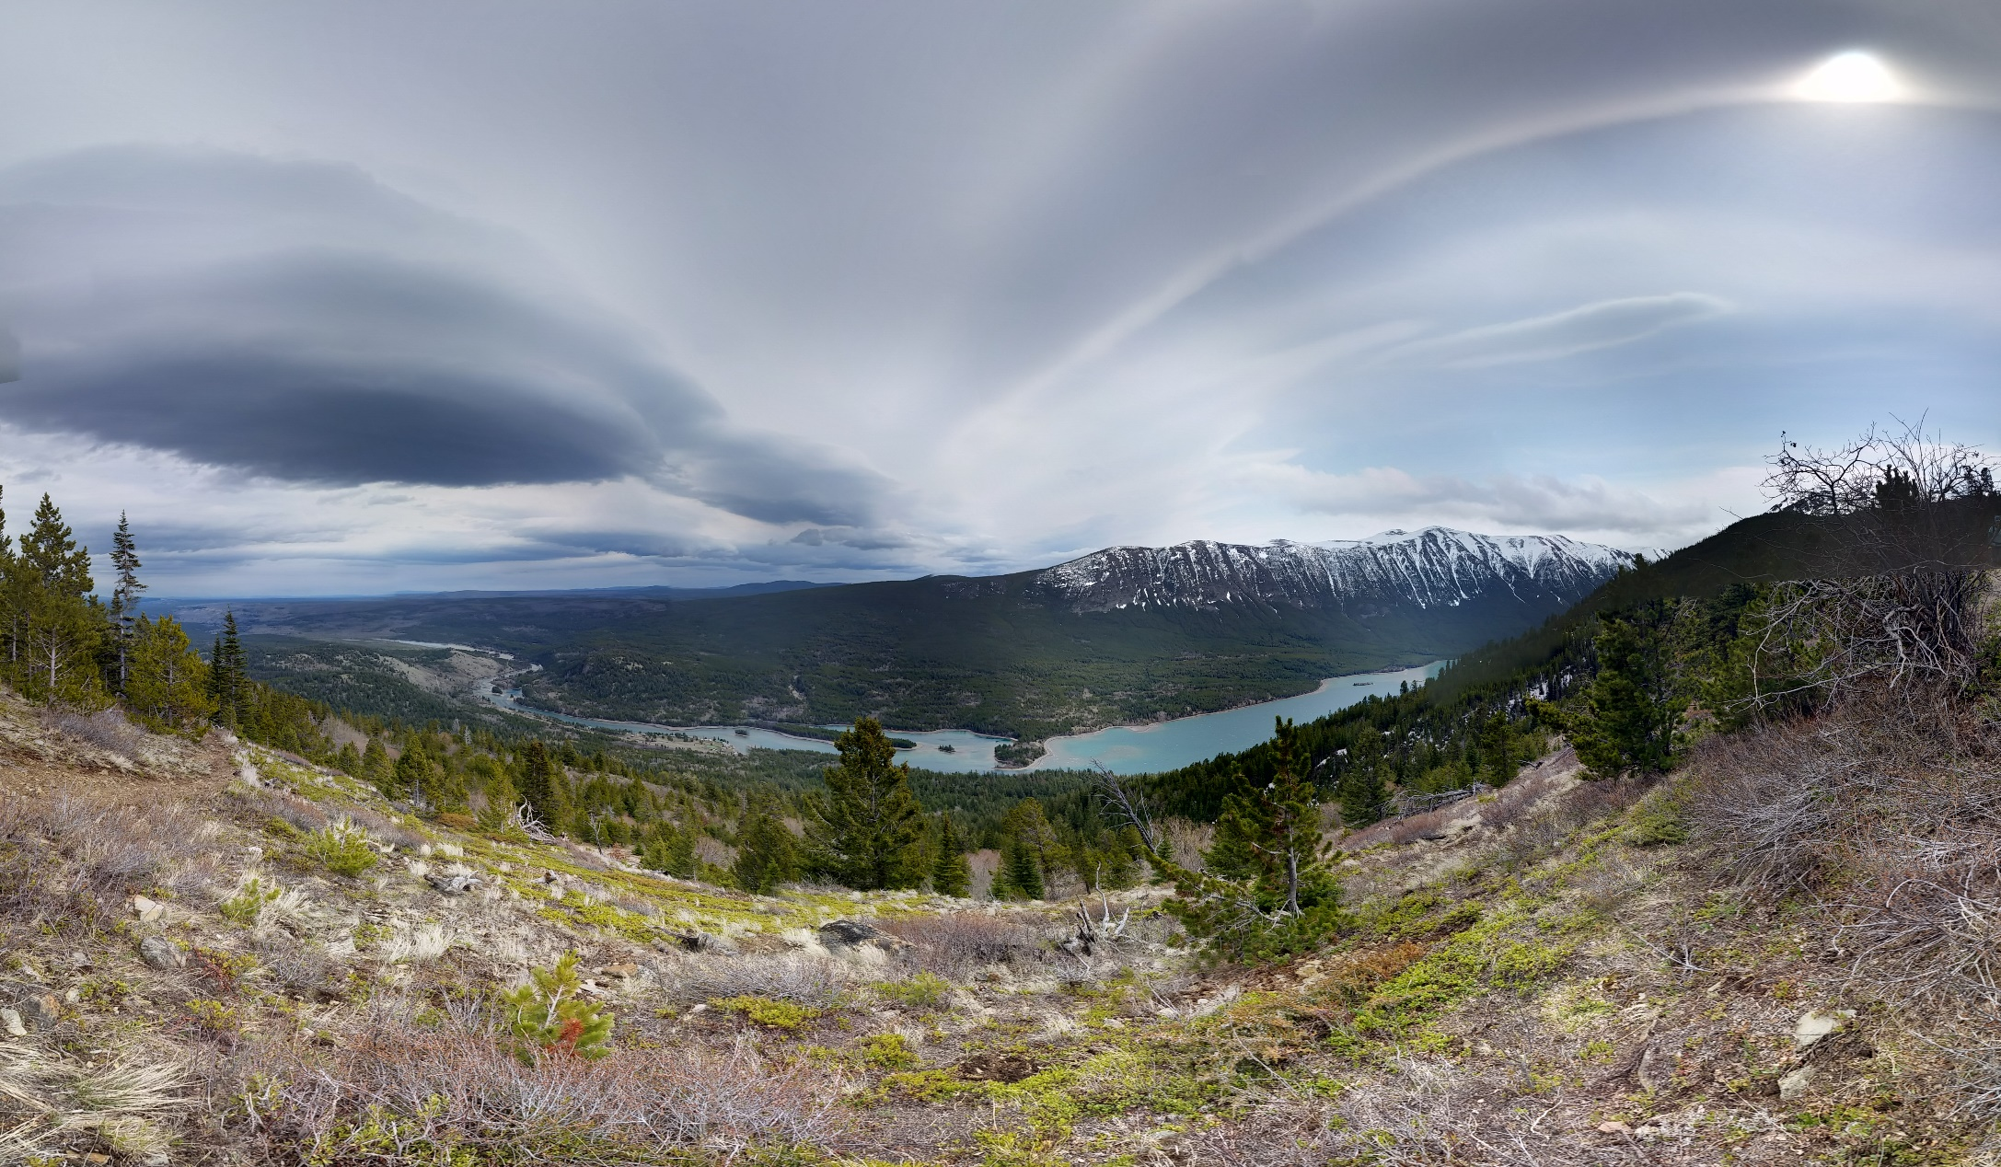
Survival is lowest here
(Clark et al. 2016, Ecological Applications)
Why?
Steve Healy

Slide 8
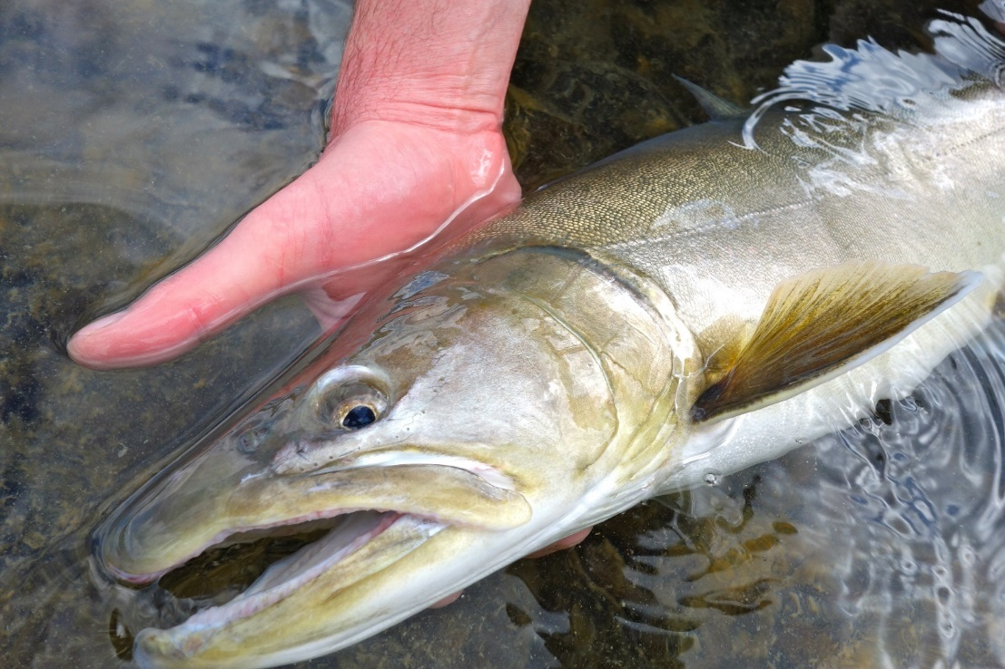
Bull trout (Salvelinus confluentus)
Notes:
Relationship to brookies – scientific name?
Distributions of sockeye and bull trout – maps!

Slide 9
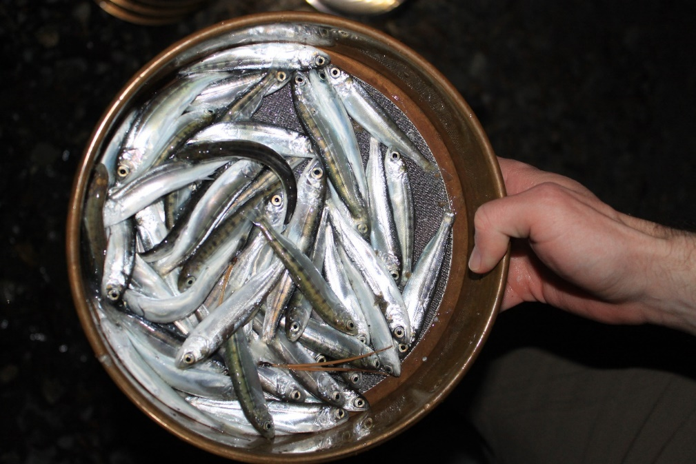
Furey et al. 2016
Journal of Animal Ecology
Furey et al. 2015
Journal of Fish Biology

Slide 10
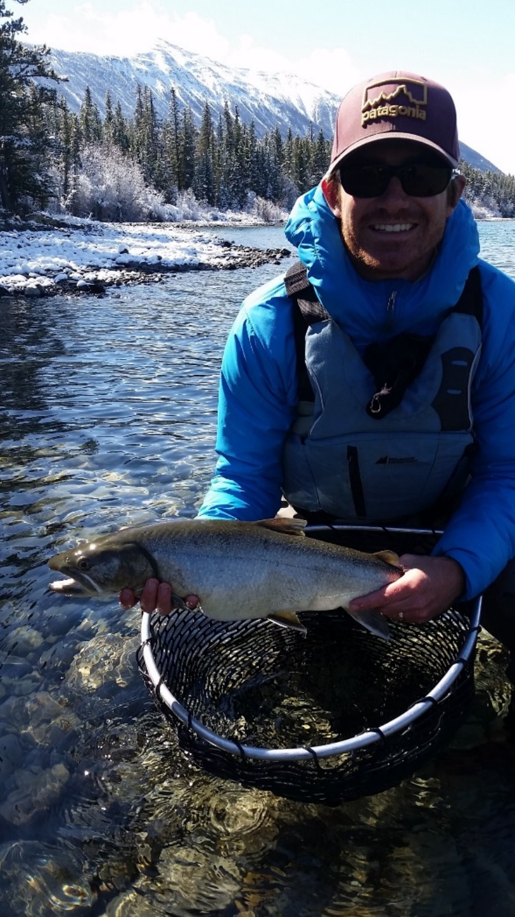
Short-term consumption is similar across temperatures…
…even the cold ones
How do they do it?
Notes:
Remove this plot

Slide 11
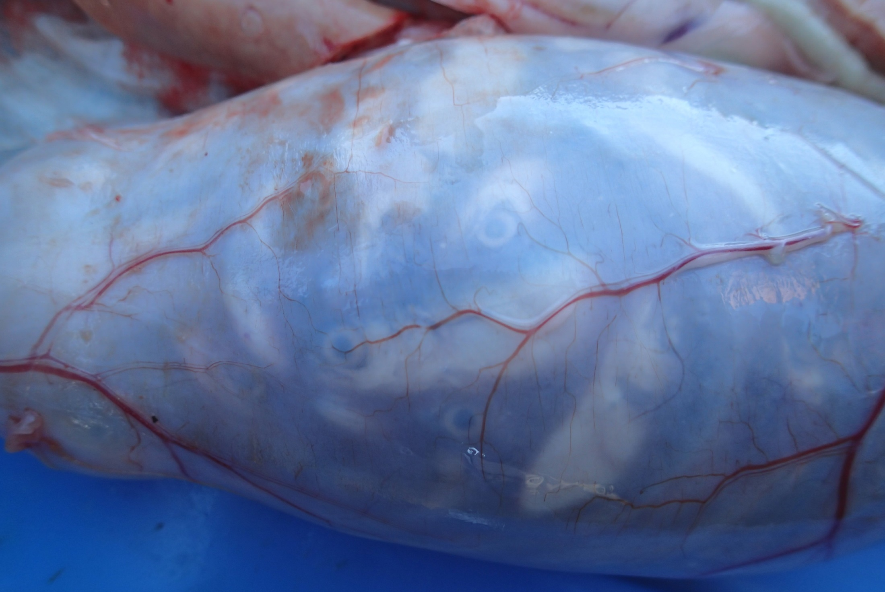
5 cm
Notes:
Scale? Title? Another photo of bull trout size – sense of scale

Slide 12

What types of smolts do bull trout eat?

Slide 13
Bull trout are more likely to eat:
Smaller smolts
Smolts infected with infectious hematopoietic necrosis virus (IHN)

Slide 14
How do smolts maximize survival?
By swamping predators

Slide 16
Furey et al. 2016b
Journal of Animal Ecology
Notes:
Animate bottom and top half of dot/box and whisker plots

Slide 17
How do smolts influence bull trout movements?

Slide 18
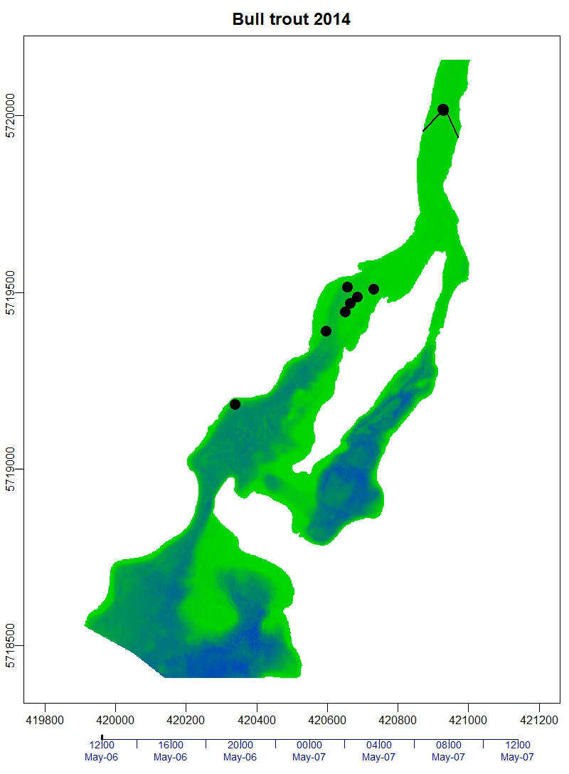
Furey and Hinch 2017, Transactions of the American Fisheries Society

Slide 19

Do salmon influence bull trout movements at broader scales?

Slide 20
TAKE HOME MESSAGES
Smolt migrations influence bull trout feeding and behavior
Bull trout predation may assist with “migratory culling” for smolts
Federally and provincially managed species can interact
Thank you! n.b.furey@gmail.com

